Slide 1

CREDIT CARD FRAUD ANALYSIS USING PREDICTIVE MODELING
Presented by :
P. Samyuktha (16AR1A0591)
M. Priya (16ARA10566)
P. Sai Lakshmi (16AR1A0580)
P. Sailaja (16AR1A0586)
P. Hussain khan (16AR1A0584)
PROJECT GUIDE
DR.M.V.BRAMHANANDA REDDY
Here you can add the simple text analysis of the topic of this speech, or the cultural ideas of relevant companies and enterprises, etc. Of course, if you don't need to add such information, you can delete it directly, thank you, wish you success.

Slide 2
CONTENTS
01
02
03
04
Abstract
Existing system
Cons of existing system
Proposed system
05
06
Pros of proposed system
Hardware and Software components

Slide 3
01-
Abstract
Billion dollars of amount is causing lose everyday by fraudulent credit card transactions. The design of efficient fraud detection algorithms is key for reducing these losses and more and more algorithms relay on advanced machine learning techniques to assist fraud investigators.
In this thesis we aim to provide some answers by focusing on crucial issues such as
1. Why and How under sampling is useful in the presence of class imbalance.
2. How to deal with unbalanced and evolving data streams.
3. How to asses performances in a way which is relevant for detection.

Slide 4
02-
Existing system
The credit card fraud analysis is highly researched field, there are many different algorithms and techniques for performing the credit card fraud analysis.
The following algorithms in existing system.
1.Support Vector Machine
2.KNN Classifier

Slide 5
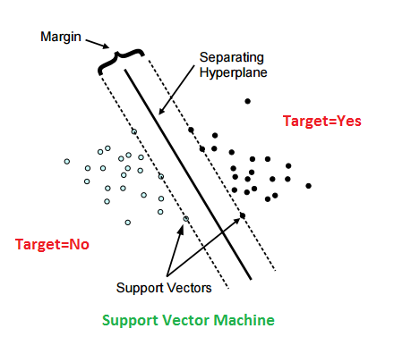
Support Vector Machine
Support Vector Machine is a supervised machine learning algorithm which can be used for both classification and regression challenges.
SVM constructs a hyperplane in a infinite dimensional space which can be used for classification, regression or outliers detection.

Slide 6
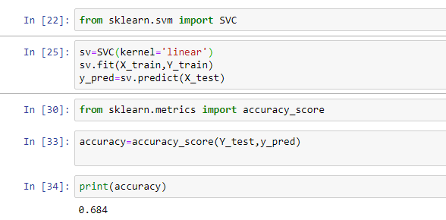
Accuracy Checking:

Slide 7
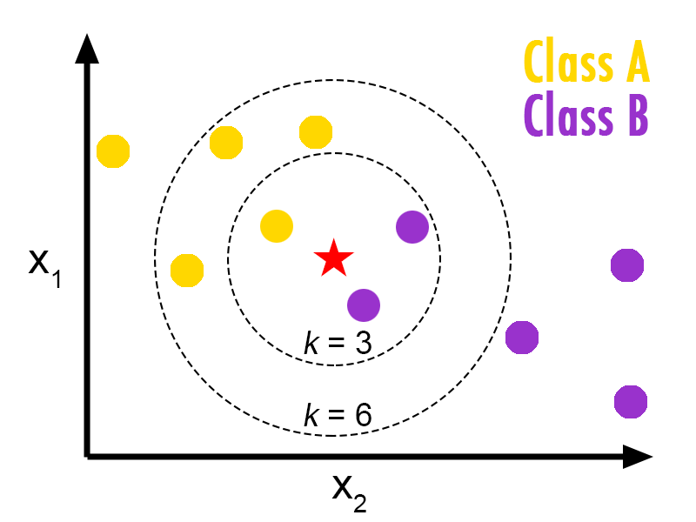
KNN Classifier
KNN algorithm at the training phase just stores the dataset and when it gets new data, then it classifies that data into a category that is much similar to the new data.

Slide 8
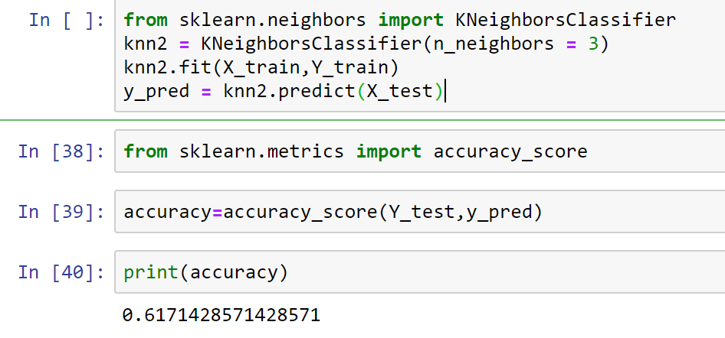
Accuracy Checking:

Slide 9
03-
Cons of existing system
Lack of efficiency
Normal to fraud transactions and vice versa
Algorithms are not much useful for this detection
Kernel busy during code execution
Decreasing accuracy levels

Slide 10
04-
Proposed system
Our goal is to implement machine learning model in order to classify , to the highest possible degree of accuracy.
Classification
Random forest
Classification is the problem of identifying to which set of categories a new observation belongs on the basis of training set of data containing observations.
Logistic Regression

Slide 11
1
Logistic regression is a machine learning algorithm which is used for the classification problems.
It is a predictive analysis algorithm and based on the concept of probability.
2
Logistic
Regression
3
It uses cost function can be defined as the sigmoid function also known as logistic function.
4
In order to map predicted values to probabilities , we use sigmoid function.
This function maps any real value into another value between 0 & 1.
5

Slide 12
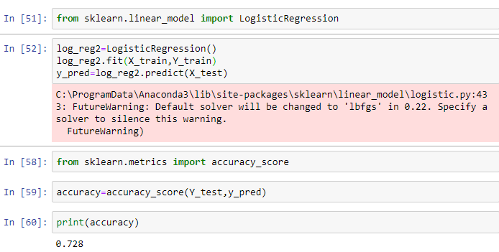
Accuracy Checking

Slide 13
Random forest is an ensemble learning method for classification and regression.
1
Can be used to rank the importance of variables in a regression or classification problem in a natural way.
2
Collection of decision trees is called a random forest.
Random forest
3
It plays a key role for 1 lakh column of dataset.
4
Random forest is applicable for both classification and regression
5
This comes under supervised learning algorithm.
6
Decision trees → Comparison → Best solution.
7

Slide 14
Data set
Tree1
Tree2
Tree3
Mean
Prediction

Slide 15
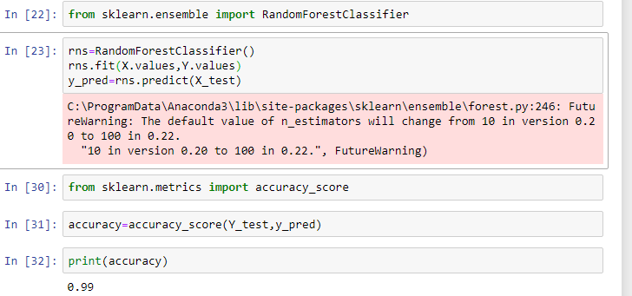
Accuracy Checking

Slide 16
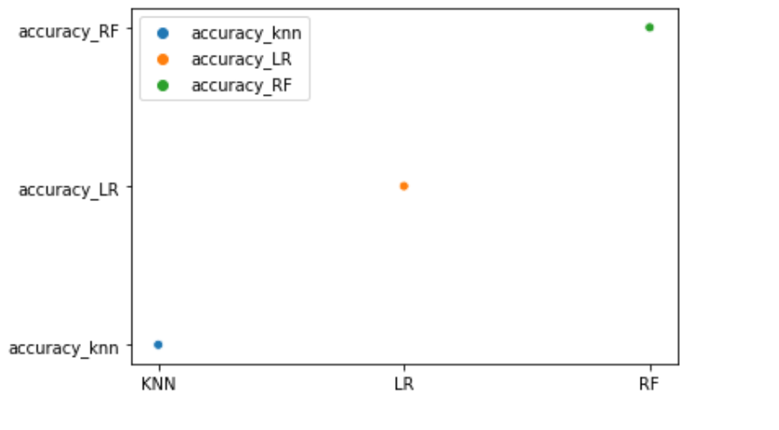
Accuracy
Graph

Slide 17
05-
Pros of Proposed system
Accuracy and efficiency is high
Less time
Applicable for huge data sets
Cannot predict normal to fraud transactions and vice versa

Slide 18
RAM : 4GB Higher
Hardware Requirements
Precessor : Intel i3 and above
Hard Disk : 500 GB : Minimum

Slide 19
OS : Windows or LINUX
Software Requirements
Python IDE : Python 2.7. x and above
Anaconda Navigator , Jupyter Notebook
Language : Python Scripting

Slide 20
THANK YOU

